Slide 1
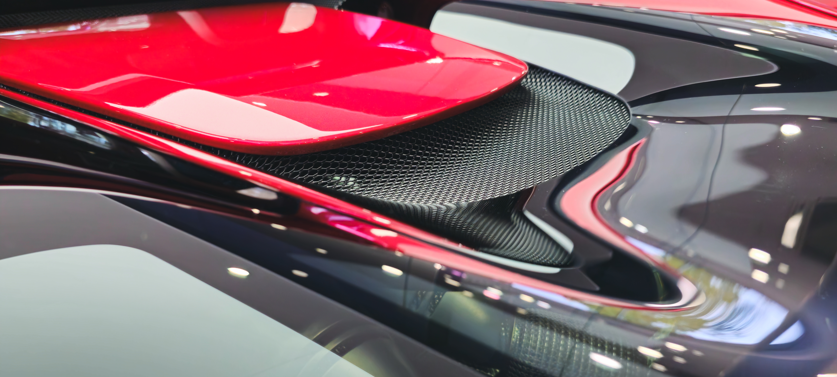

A Photographer’s Guide
​​
©VRI 2026
v1.6

Slide 2
Contents
3 - Introduction
4 - The Photographer’s Checklist: Key Requirements
5 - Vehicle Exterior Photography: A Comprehensive Starter Guide​
6 - Ultimate Guide to Vehicle Exterior Photography
8 - Vehicle Exterior – Land Vehicle Checklist
9 - Vehicle Exterior – Air Vehicle Checklist
10 - Vehicle Exterior – Sea Vehicle Checklist
11 - Vehicle Interior Photography: A Comprehensive Starter Guide
12 - Ultimate Guide to Vehicle Interior Photography​
14 - Vehicle Interior – Land Vehicle Checklist
16 - Vehicle Interior – Air Vehicle Checklist
17 - Vehicle Interior – Sea Vehicle Checklist
19 - Key Points​
25 - Get in touch

Slide 3
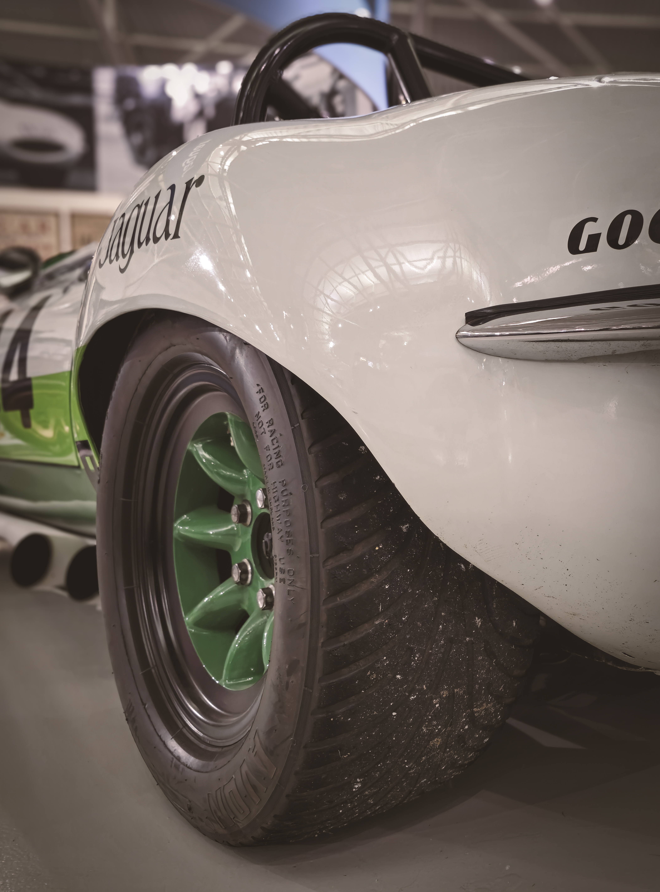
Introduction
Photography Journey
Welcome to your comprehensive guide to capturing stunning images that meet our website’s standards. This guide will ensure that your photographs adhere to our policy requirements, ensuring high-quality images for our audience. We recommend printing or downloading a copy of this guide for easy reference during your photography sessions. When taking photos, you have the flexibility to shoot in either landscape (horizontal) or portrait (vertical) orientation, as long as the essential details are clearly captured. To maintain the highest image quality, we require a minimum resolution of 20 megapixels. This ensures that every detail is sharp and visible. For the best results, we recommend using a DSLR camera or a high-end smartphone with at least 40 megapixels. This guide is designed to cater to all types of vehicles, providing specific instructions on the kind of images we are looking for. Whether you are photographing a compact car, a heavy-duty truck, or any other vehicle type, this guide will assist you in capturing the perfect shots.

Slide 4
The Photographer’s Checklist: Key Requirements
Obtain permission from the owner before proceeding.
Ensure both the exterior and interior of the vehicle are thoroughly cleaned.
Remove any personal items from the interior before capturing images.
Eliminate any identification elements, such as number plates and serial numbers.
Avoid submitting photos with blurred images.
Submit only high-resolution images; ensure a minimum of 20-35 megapixels for sharpness and clarity.
Capture every detail possible in your photos. Provide close-up shots with optimal detail and clarity by submitting high-resolution images. Aim for a recommended range of 35-50 megapixels to capture every detail in your photos.
Use only your own images for submission.
Capture photos in a well-lit open environment to showcase the vehicle effectively. If available, a studio would be the ideal location for presenting your vehicle.
Avoid adding grain, vignettes, fake lens flares, film scratches, etc., as these may lead to rejection during the evaluation process.
Maintain natural colours in your photos.
We kindly suggest that you upload images in the JPEG format. While we do accept other formats, JPEG is our top preference. Also, please ensure that each image does not exceed 15 megabytes.

Slide 5
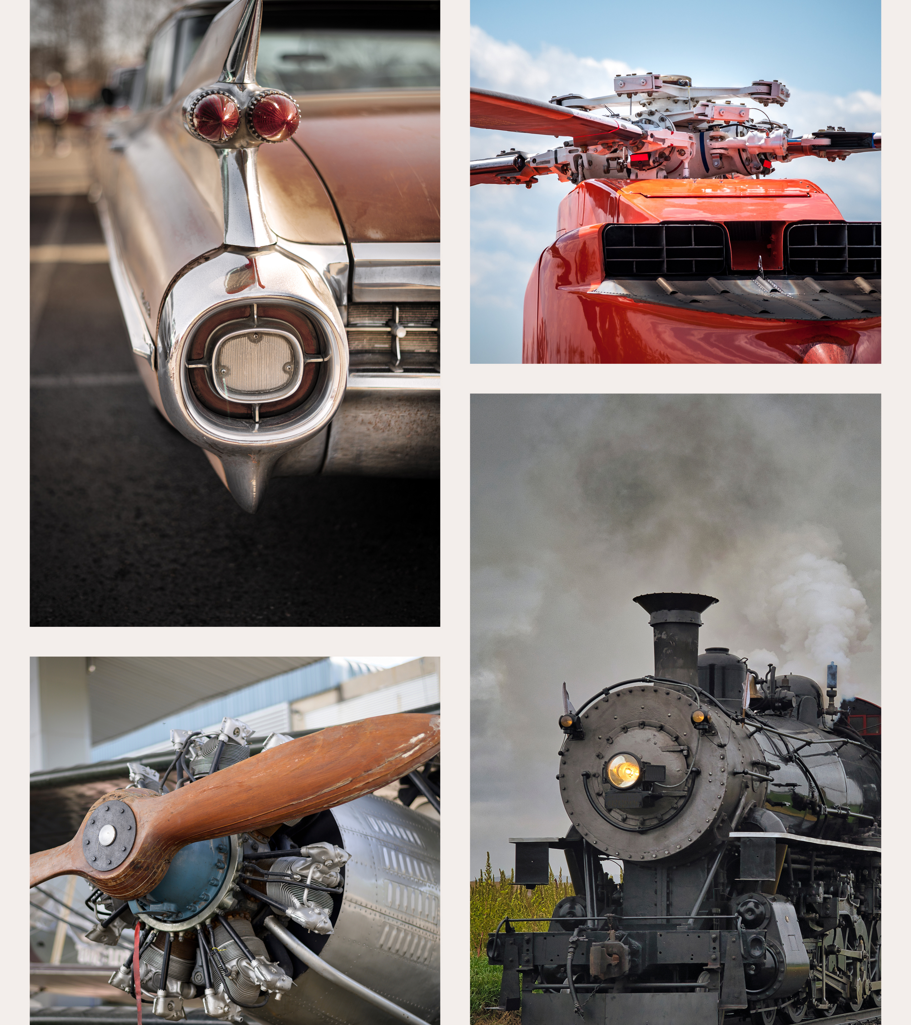
Vehicle Exterior Photography: A Comprehensive Starter Guide
This resource is designed to help you identify key areas to photograph on your vehicle, ensuring you capture every important detail. Our checklist highlights crucial spots, but thorough photography will also reveal areas not listed in this guide. This guide is a perfect starting point for anyone looking to enhance their vehicle photography skills.
Remember, the more photos you take, the better! By capturing as many angles and details as possible, you’ll ensure no aspect is missed. Once you've taken your photos, sort them carefully to create a complete and organised visual record.
Let's get started on making your vehicle photography both thorough and impressive!

Slide 6
Ultimate Guide to Vehicle Exterior Photography
Photographing the exterior of a vehicle requires careful consideration of lighting, angles, and composition to highlight its design and features effectively. Here are some tips to ensure your exterior vehicle photos are professional and captivating:
Optimal Lighting
Golden Hour: The best time for shooting exterior shots is during the golden hour (shortly after sunrise or before sunset). The soft, warm light during this time reduces harsh shadows and highlights.
Avoid Midday Sun: Shooting under direct midday sunlight can create unflattering shadows and highlights. If you must shoot during the day, try to find shaded areas to ensure even lighting.
Perfect Locations and Conditions
Location: Choose a clean, uncluttered background that complements the vehicle. Avoid busy or distracting backgrounds that can take focus away from the vehicle. Ensure the ground is clean and free of debris, as it can reflect on the vehicle's surface and distract from the overall look.
Preparation: Wash and detail the vehicle thoroughly before the shoot. A clean, polished exterior will look significantly better in photos. Remove any personal items or accessories that do not add to the vehicle's presentation.

Slide 7
Ultimate Guide to Vehicle Exterior Photography
Composition
Wide Shots: Capture the entire vehicle from different angles – front, side, rear, and three-quarter views. This provides a comprehensive view of the vehicle's design.
Detail Shots: Focus on unique exterior features such as the grille, headlights, wheels, and badges. These close-ups highlight the craftsmanship and design elements.
Camera Settings
ISO: Use a low ISO setting to ensure clear, high-quality images without grain.
Aperture: A mid-range aperture (f/8 to f/11) provides a good depth of field, keeping the vehicle in sharp focus while slightly blurring the background.
Stability: Use a tripod for stability, especially if shooting in low light conditions, to avoid camera shake and ensure sharp images.
Reflections
Minimise Reflections: Pay attention to reflections on the vehicle’s surface. Avoid having your reflection, camera equipment, or unwanted objects visible in the shot. Adjust your position or use a polarising filter to minimise reflections.

Slide 8
Side profile: Capture both sides of the vehicle to show off its lines and shape.
Close-ups of badges and logos: These details can enhance the context of your photos. Additionally, if the vehicle has decals or liveries, be sure to include them in your shots.
Interior shots from outside: Open the door and take a photo of the interior from an exterior perspective.
Detail shots: Close-ups of interesting design elements like the grille, trim details, or wheel design.
Trunk/Boot space: An open trunk/boot can give an idea about the size and form of the vehicle.
Head-on front (with/without headlights on): This shot captures the front design of the vehicle. Turning the headlights on can highlight the design of the lights.
Head-on rear (with/without taillights on): Like the front, this shows off the rear design. The taillights on can accentuate the vehicle's back end and show how it looks on the road.
Front and/or rear wheels (depending on the size): A close-up of the wheels can show off their design. It can also give a sense of the vehicle’s stance and performance capability.
Engine: A photo of the engine can be important for car enthusiasts. It gives a sense of the vehicle’s power and intricate engineering design.
Each headlight/taillight: Close-ups of the headlights or taillights can highlight their design, which contributes to the overall aesthetic of the vehicle.
Undercarriage: While not always the most glamorous photo, a shot of the undercarriage can reveal important information about the vehicle’s drivetrain and exhaust system.
Mirrors: Photos of the mirrors can show their design. They’re a small detail, but they contribute to the overall look of the vehicle.
Roof: A shot of the roof is especially important if the vehicle has a sunroof or moonroof. It can also reveal any additional details on the panel, such as creases and roof rails.
Vehicle Exterior – Land Vehicle Checklist

Slide 9
Vehicle Exterior – Air Vehicle Checklist
Front View: This shot captures the nose of the airplane, including the cockpit windows. It can give a sense of the size and design of the aircraft.
Side View: A side view can show the length of the aircraft, the number of windows, and the placement of the wings and engines.
Rear View: The rear view can highlight the tail design, which often includes the airline’s logo. It also shows the arrangement of the rear control surfaces.
Undercarriage: A photo of the undercarriage, including the landing gear, can be interesting, especially if the gear is extended.
Engines: Close-ups of the engines can show their size and complexity. This is especially impressive on large jet aircraft.
Wings: The wings of an aircraft are a key feature. Photos can show their shape, size, and the placement of flaps and other control surfaces.
Tail: The tail, or empennage, includes the vertical and horizontal stabilisers. Photos can show their size and shape, as well as the placement of control surfaces like the rudder and elevators.
Aircraft Body: Close-ups of the aircraft body can show the construction details of the panels and any other notable features. Also, any logos or artwork that might be on the body.
Main Rotor: The main rotor of a helicopter is a key feature. Photos can show their shape, size, and the placement of rotor blades.
Tail Rotor: The tail rotor, or anti-torque rotor, is a smaller rotor mounted so that it rotates vertically or near-vertically. Photos can show their size and shape.

Slide 10
Vehicle Exterior – Sea Vehicle Checklist
Bow (Front View): This shot captures the front of the boat or yacht. It can give a sense of its size and design.
Stern (Rear View): The rear view can highlight the boats or yacht’s back end, including any name or home port details.
Starboard and Port (Side Views): These views can show the length of the boat or yacht, the number of windows or portholes, and the placement of the superstructure and decks.
Top View (From Above): If possible, a top-down view can show the layout of the decks, including any outdoor seating areas, the helm station, and other features.
Underwater Hull: A photo of the underwater part of the hull, if possible, can be interesting. It shows the shape of the boat and any keel or rudder details.
Interior Cabin: If accessible, photos of the interior can show the condition and layout of the living and sleeping quarters.
Engine Room: A photo of the engine room can provide valuable information about the boats or yacht’s power and intricate engineering design.
Deck Gear: Close-ups of winches, cleats, anchors, and other deck gear can show their detail and construction.
Mast and Rigging: For sailboats, photos of the mast, sails, and rigging are important. They show the textures of the sails and the complexity of the rigging.

Slide 11
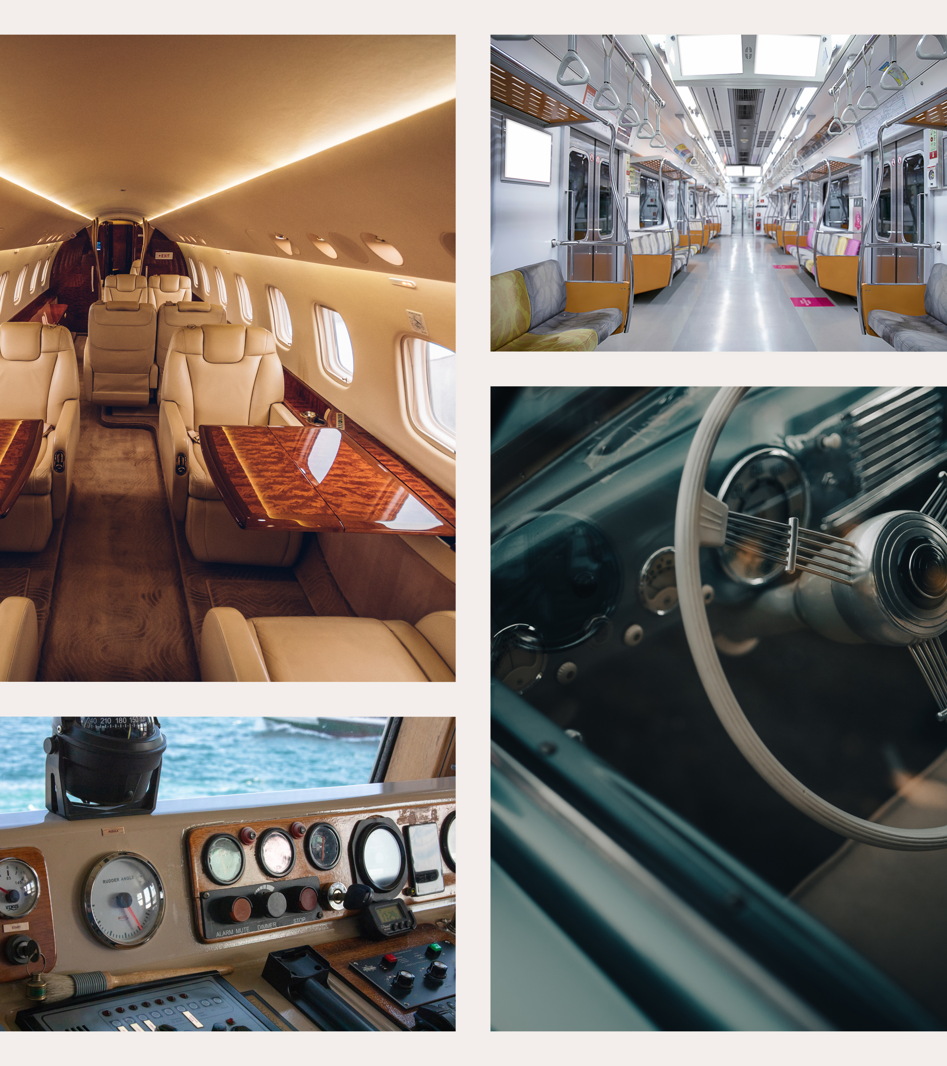
Vehicle Interior Photography: A Comprehensive Starter Guide
This resource is designed to help you identify key areas to photograph inside your vehicle, ensuring you capture every important detail. Our checklist highlights crucial spots, but thorough photography will also reveal areas not listed in this guide. This guide is a perfect starting point for anyone looking to enhance their vehicle interior photography skills.
Remember, the more photos you take, the better! By capturing as many angles and details as possible, you’ll ensure no aspect is missed. Once you've taken your photos, sort them carefully to create a complete and organised visual record.
Let’s get started on making your vehicle interior photography both thorough and impressive!

Slide 12
Ultimate Guide to Vehicle Interior Photography
Capturing the perfect interior shots of a vehicle requires attention to lighting, angles, and detail. Follow these tips to ensure your photos showcase the vehicle's interior in the best possible way:
Optimal Lighting
Even Lighting: Shoot during the daytime, ideally in shaded areas. This provides consistent and soft lighting that avoids harsh shadows and highlights.
Avoid Direct Sunlight: Direct sunlight can create uneven lighting and harsh shadows, which obscure details. If shooting outside, a cloudy day can provide natural diffused light.
Preparation
Clean the interior thoroughly to remove any dust, smudges, or clutter. A pristine environment highlights the features and gives a professional look to your photos.
Adjust the seats, steering wheel, and other elements to showcase the space and comfort of the interior.

Slide 13
Ultimate Guide to Vehicle Interior Photography
Photographer's Presence
Ensure that you are not visible in any reflective surfaces such as mirrors, windows, or glossy dashboard elements. Position yourself and the camera at angles where reflections are minimised.
Composition
Wide-Angle Shots: Use a wide-angle lens to capture the full scope of the interior. This helps in showcasing the space and layout effectively. Use a wide-angle lens to capture the full scope of the interior. This helps in showcasing the space and layout effectively.
Detail Shots: Include close-up shots of unique features, materials, and craftsmanship. This might include stitching on seats, dashboard controls, or infotainment systems.
Perspective: Shoot from various angles - front, back, and sides - to provide a comprehensive view of the interior.
Camera Settings
Use a low ISO setting to avoid graininess and maintain clarity.
A higher aperture (f/8 to f/16) ensures a greater depth of field, keeping the entire interior in focus.
Stabilise your camera with a tripod to avoid blur from hand movements, especially in low light conditions.

Slide 14
Vehicle Interior – Land Vehicle Checklist
Wide shot of entire dashboard driver-side: Capture the entire dashboard from the driver’s perspective, including all controls and displays.
Gauge cluster: Focus on the instrument panel, capturing details such as the speedometer, tachometer, fuel gauge, and any digital displays.
Steering wheel head-on: Take a direct front view of the steering wheel, showing any buttons or controls it may have.
Wide shot of entire dashboard passenger-side: Capture the entire dashboard from the passenger’s perspective, highlighting any features unique to this side.
Entire dashboard from rear seats: Show the view of the dashboard from the back seats, giving a sense of the overall layout and space.
Glovebox (open and closed): Take pictures of the glovebox in both open and closed states, showing storage capacity and any interior features.
Footwells (with/without mats): Show the space in the footwells, both with and without floor mats.
Pedals: Capture the pedals from the driver’s side, showing their layout and any wear or special features.
Centre stack, console, and shifter: Highlight the center console area, including the gear shifter, storage areas, and any controls or displays.
Front seats from driver-side: Take a picture of the front seats from the driver’s side, showing the condition and features of the seats.
Driver’s seat picture from front (with entire seat visible): Capture the driver’s seat from the front, showing the entire seat including any controls for adjustment.
Area behind front seats (if applicable): If there’s space or features behind the front seats, capture this area.
Door panels and headliner: Show the inside of the doors and the roof of the car, highlighting materials and any features like speakers or controls.
Trunk/Boot: Capture the trunk or boot space, showing its capacity and any features like a spare tire or storage compartments.
Driver-side 3/4 view from rear: Take a picture from the rear at a 3/4 angle on the driver’s side, showing the rear and side profile of the vehicle.
Driver-side profile (side on): Capture a side-on view of the driver’s side, showing the lines and shape of the vehicle.
Driver-side 3/4 view from front: Take a picture from the front at a 3/4 angle on the driver’s side, showing the front and side profile of the vehicle.
Passenger-side profile (side on): Capture a side-on view of the passenger’s side, showing the lines and shape of the vehicle.
Passenger-side 3/4 view from rear: Take a picture from the rear at a 3/4 angle on the passenger’s side, showing the rear and side profile of the vehicle.
Passenger-side 3/4 view from front: Take a picture from the front at a 3/4 angle on the passenger’s side, showing the front and side profile of the vehicle.

Slide 15
Vehicle Interior – Land Vehicle Checklist
Rear seats (wide shot and close-up): Ensure you capture both the entire rear seating area and detailed shots of the seats themselves.
Rear seat legroom and footwells: Show the space available for passengers.
Center console storage (open and closed): Highlight the storage options available.
Door pockets and storage compartments: Showcase the additional storage spaces in the doors.
Armrests (front and rear): Include shots of armrests, especially if they have storage or other features.
Infotainment system and controls: Detailed shots of the screen and buttons/knobs.
Climate control vents and controls: Show the locations and types of vents and how the climate is controlled.
Interior lighting: Capture any ambient lighting, reading lights, or special lighting features.
Sunroof/Moonroof (if applicable): Both open and closed positions.
Seat adjustments and controls: Highlight how the seats are adjusted, including any electronic controls.
Rearview mirror and visors: Detail shots of these often-used parts.
Safety features: Show airbags, seatbelt details, and any other safety-related features.
Interior materials and stitching: Close-up shots of the materials used on seats, dashboard, and other surfaces.
Sound system: Photos of the speakers, subwoofers, or branded audio systems.
Special features: Any unique features like cup holders, USB ports, wireless charging pads, or built-in screens.

Slide 16
Cockpit Wide Shot: A comprehensive view of the entire cockpit, including all instruments and controls.
Pilot and Co-Pilot Seats: Head-on and side shots of the pilot and co-pilot seats, showing seating arrangements and adjustments.
Instrument Panel: Close-up of the instrument panel, highlighting key instruments and displays.
Control Yokes and Pedals: Detailed shots of the control yokes or sticks and the foot pedals.
Overhead Panel: Captures the overhead controls and switches, showcasing the cockpit’s full range of controls.
Avionics and Communication Equipment: Close-up of the avionics and communication systems, showing detailed controls and displays.
Cockpit Door: View of the cockpit door and entrance area.
Cabin Wide Shot: A comprehensive view of the entire cabin from front to back, highlighting seating arrangements and space.
Seats: Close-ups of individual seats, showing cushions, controls, and legroom.
Overhead Bins: Shots of overhead bins both open and closed.
Galley: Detailed shots of the kitchen area, including equipment and storage.
Lavatories: Interior and exterior shots of lavatories.
Emergency Exits and Safety Equipment: Showcases emergency exits, life vests, and oxygen masks.
Windows and Shades: Detailed shots of cabin windows and window shades.
In-Flight Entertainment Systems: Close-up of entertainment screens and controls.
Cargo Hold: Views of the cargo hold both open and closed.
Service Areas: Captures service areas and crew rest compartments if applicable.
Vehicle Interior – Air Vehicle Checklist

Slide 17
Vehicle Interior – Sea Vehicle Checklist
Bridge Wide Shot: A comprehensive view of the entire bridge, including control stations and navigation equipment.
Captain’s Chair: Head-on and side shots of the captain’s chair and surrounding controls.
Navigation Instruments: Close-ups of navigation instruments and equipment.
Communication Equipment: Detailed shots of communication systems on the bridge.
Bridge Wings: Captures the bridge wings, if applicable, showing extended control areas.
Engine Controls: Views of engine controls and monitoring systems.
Main Cabin: Wide shot of the main cabin or living area, highlighting space and layout.
Sleeping Quarters: Detailed shots of sleeping areas, including bunks and state rooms.
Galley: Detailed shots of the kitchen area, including appliances and storage.
Dining Area: Views of the dining area or mess hall.
Bathrooms: Interior shots of bathrooms and shower facilities.
Lounge Areas: Views of lounge and recreation areas.
Storage Compartments: Close-ups of storage compartments and closets.

Slide 18
Vehicle Interior – Sea Vehicle Checklist
Engine Room: Wide shot of the entire engine room, including engines and machinery.
Engine Details: Close-ups of engines, generators, and other critical machinery.
Fuel and Water Systems: Views of fuel and water system components.
Deck Equipment: Shots of lifeboats, life rafts, davits, cranes, and fishing gear.
Safety Equipment: Detailed views of fire extinguishers, life rings, and other safety gear.
Cargo Holds: Views of cargo holds both open and closed.
Wheelhouse: Detailed shots of the wheelhouse, including helm station and controls.
Radar and Antennae Masts: Captures radar and communication masts.
Swim Platform: Detailed shots of the swim platform and boarding ladders.
Interior Lighting: Views showcasing interior lighting and ambiance.
Upholstery and Materials: Close-ups of upholstery and materials used in seating and finishes.
Special Features: Shots of unique features like hot tubs, bars, and entertainment systems.
Navigation Charts: Detailed views of navigation charts and route planning areas.

Slide 19
Key Points
Image Quality
File Formats
File Size
Aspect Ratio and Orientation
Editing and Post-Processing
Copyright and Permissions
Descriptive Metadata
Uploading Process
Image Optimisation
Legal Considerations

Slide 20
Key Points
Image Quality: We encourage users to upload high-resolution images to ensure that their photos look sharp and professional on our website. High-resolution images can significantly enhance the visual appeal of your content and provide a better user experience.
We recommend uploading images with at least 20 megapixels resolution. This ensures your images maintain clarity and sharpness across various screen sizes, from mobile devices to desktop monitors. For detailed close-ups of vehicles, we advise a minimum resolution of 35 megapixels to capture every intricate detail and texture.
It’s also important to consider the lighting and focus when taking your photos. Good lighting can bring out the details and colours in your photos, while proper focus can prevent your images from appearing blurry. Avoid underexposed photos, which can look dark and make it hard to see the details. Remember, a well-lit and sharply focused photo can make a big difference in how professional your content appears.
2. File Formats: We accept a variety of file formats for images, but we particularly recommend using JPEG (Joint Photographic Experts Group) format. This format is widely supported and offers a good balance between image quality and file size.
JPEG is a commonly used format for photos. It uses lossy compression, which means some image data is lost for it to reduce the file size. However, it still maintains a high image quality, making it ideal for photographs.
JPEG offers small file sizes and universal compatibility, but it’s a lossy format which means some image quality is sacrificed. BMP provides high quality and uncompressed images, but the file sizes can be very large. RAW offers the highest quality and allows for extensive post-processing, but the files are large and not universally supported.

Slide 21
Key Points
3. File Size: This will vary from image to image. Closer shots will require higher resolution to capture every detail. Please note that high-resolution images will have larger file sizes, which may affect the upload time and storage efficiency.
To check the file size before uploading, follow these steps:
Locate the file on your device.
Right-click on the file and select ‘Properties’ (on Windows) or ‘Get Info’ (on Mac).
In the properties window, locate the ‘Size’ field to determine the file size. Keep in mind, if the file exceeds 15mb, you might have to decrease its size or resolution prior to uploading.
4. Aspect Ratio and Orientation: The aspect ratio, while important, is not the most crucial element when it comes to capturing the perfect photo of your vehicle. The detail and content of the image should be the priority. However, here are some guidelines that might help:
Standard Aspect Ratios: While there are standard aspect ratios like 4:3 and 16:9 that are commonly used and work well with most viewing angles, don’t feel restricted by these. Choose an aspect ratio that best captures the detail and subject of your photo.
Landscape or Portrait Orientation: The choice between landscape or portrait orientation largely depends on your photo and how much detail you want to convey. Landscape orientation is generally preferred for panoramic views or when you want to capture a wide area. On the other hand, portrait orientation works well for vertical subjects or to create a sense of height or depth. Remember, the orientation should serve to enhance the detail and subject of your photo, not restrict it.

Slide 22
Key Points
5. Editing and Post-Processing: Here are some tips on basic photo editing techniques to enhance your images before uploading:
Cropping: This can help improve the composition of your photo, remove unwanted elements, or focus on a particular subject.
Adjusting Brightness and Contrast: Brightness controls the overall lightness or darkness of the image. Adjusting it can help make a photo look more balanced and vibrant. Contrast, on the other hand, affects the difference between the light and dark areas of an image. Increasing contrast can make your photo look more dramatic.
Colour Correction: This involves adjusting the hue and saturation of an image to make the colours more accurate or aesthetically pleasing. It’s important to keep colours natural, especially body panels and textures.
Applying Filters: While filters can add a unique look or mood to your photos, it’s crucial not to overdo them. Too much filter use can make a photo look artificial or overly processed. Aim to keep your photos as natural-looking as possible.
Photo Editing Software: There are numerous free and paid photo editing software available. Free options include GIMP and PhotoScape, while paid options include Adobe Photoshop and Lightroom. Mobile apps like Snapseed and VSCO are also great for quick edits on the go.
6. Copyright and Permissions: It’s crucial to respect copyright laws and the rights of others when uploading images. Here are some guidelines:
Only Upload Your Own Images: You should only upload images that you have taken yourself or have explicit permission to use. This ensures that you respect the rights of the original creator.
Legal Implications of Copyright Infringement: Unauthorised use of copyrighted material can lead to legal consequences. This could include fines, damages, and in some cases, even criminal penalties. It’s important to understand that copyright infringement is a serious offense.
Remember, respecting copyright laws and the rights of others is not just a legal requirement, but also a matter of ethics and respect for the work of others. Always ensure you have the necessary permissions before uploading any images.

Slide 23
Key Points
7. Descriptive Metadata: Encourage users to include metadata like titles, captions, and tags to make their images more searchable and informative.
Guide on Writing Effective Titles: When writing a title for an image, it’s important to be as descriptive and accurate as possible. For example, if the image is of a car, the title could be “Rear Tyre - Tesla Model S”.
Image Description: For the convenience of users searching for your image, it’s advantageous to offer a comprehensive description of the image’s content. For example, “The image features a 2024 Tesla Model S in Midnight Silver Metallic. Highlight the vehicle in the description, it doesn’t need to be lengthy.”
Importance of Tagging: Tags are crucial for making images more discoverable. They should include relevant keywords that describe the image content and context. For the car image example, relevant tags could be “Tesla”, “Model S”, “2024”, “Electric Car”, “Midnight Silver Metallic”, and “Tyre”. Including the exact release date of the vehicle, such as “2024”, can also be helpful for users searching for specific models and years.
Remember, the more detailed and accurate your metadata, the easier it will be for others to find and understand the context of your image.
8. Uploading Process: VRI is always looking for new content to enrich our collection. Here’s a step-by-step guide on how to upload images to VRI:
Step One: Select and Upload your image(s): To begin, go to the Upload page and click on the ‘+ Select Images’ button. This will open an uploading window where you can choose the images you want to upload. We accept various formats, but JPEG is our preferred image format. You can add a maximum of 30 images at once. After selecting the images, click the ‘Upload’ button.
Step Two: Inserting additional metadata: After you’ve chosen your images for upload, it’s time to assign titles and descriptions. Make sure all necessary fields are filled out - this is key to a successful upload. You can assign unique keywords to each image, which will help users find your images more easily. Click the ‘Update entry’ button to securely store the metadata associated with each image.
Step Three: Finalise the Upload: Once you’ve prepared your images and filled in all the necessary information, press the ‘Submit’ button to send them for review.
Troubleshooting Tips: If you encounter any issues during the upload process, such as upload errors or unsupported formats, please ensure that your images meet the technical requirements (JPEG format, minimum size of 20 megapixels). If the problem persists, please contact our support team for further assistance.

Slide 24
Key Points
9. Image Optimisation: Here are some techniques for optimising images without compromising quality:
Compression Tools: There are several tools available that can help you compress your images without losing quality. Tools like TinyPNG, JPEGmini, and Kraken.io are great for this purpose. They use lossless compression techniques to reduce the file size of your images while maintaining the original quality.
File Size: While it’s important to maintain image quality, large file sizes can slow down the website. A balance must be struck between quality and file size. For instance, if you’re uploading an image of a vehicle, ensure that the file is more than 15 megabytes to maintain a high-quality image where all the vehicle details are visible. However, remember to use compression tools to reduce the file size as much as possible without losing those important details.
Image Format: Choosing the right image format can also help optimise your images. For example, JPEG is a good option for photographs as it provides a good quality-to-size ratio.
Remember, the goal of image optimisation is to find the perfect balance between the highest quality and the smallest file size, without noticeably affecting the visual integrity of the image.
10. Legal Considerations: Users are reminded to respect privacy and obtain necessary releases if their photos include recognisable people or private property.
Users should be mindful of privacy laws, especially when photographing people in public or private spaces.
When uploading images, particularly those of vehicles, users must ensure to remove any identifiable information. This includes, but is not limited to, people’s identities, license plates, and serial numbers from the image. The image should only display the vehicle, devoid of any personal or identifiable information.
Users are advised to use image editing tools to blur or erase identifiable information before uploading. This is crucial in maintaining privacy and adhering to legal considerations.
Remember, respecting privacy is not just a legal requirement, but also a part of being a responsible and ethical member of the community.

Slide 25
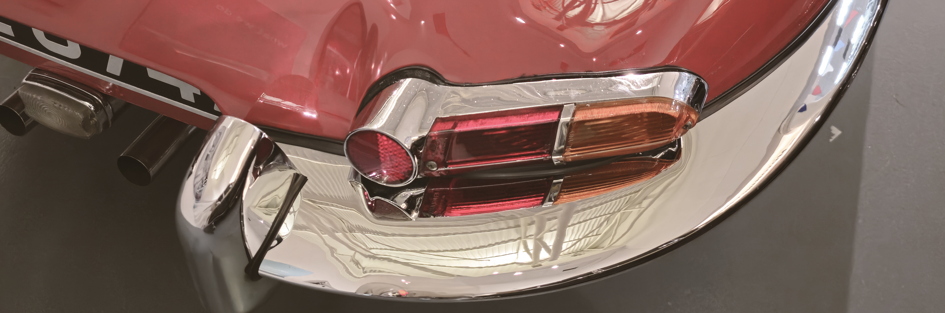
Get in touch
support@vehicle-referenceimages.com​
www.vehicle-referenceimages.com​

